Slide 1
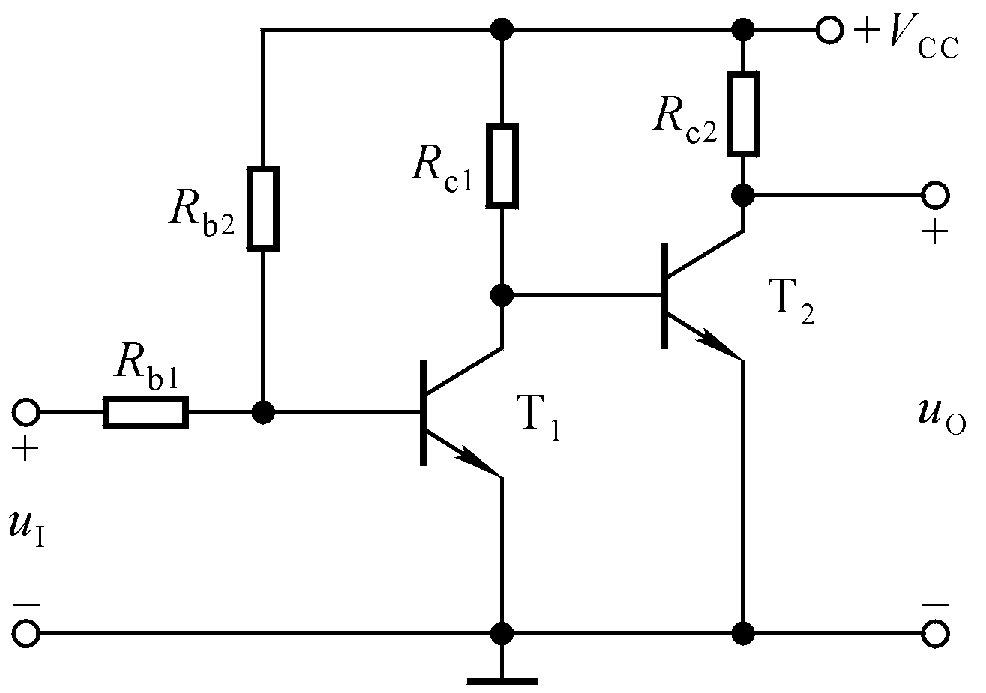
Direct coupling circuit
No need of capacitor and inductor, suitable for large-scale integrated circuits
Drawback of direct coupling circuit:
Zero-drift error 零点漂移
When input signal u_{I}=0, the output signal u_{O} is not stable, but shows a slow and random variation
Zero-drift error is due to the drift of static working point
u_{O}

Slide 2
Sources that contribute to the zero-drift error:
a) Temperature
由温度引起的零漂称为温漂
b) Aging
由元器件老化引起的零漂称为时漂
Temperature effect is the major source
Suppress the zero-drift error:
a) Negative feedback DC circuit 直流负反馈电路
b) Differential amplifier circuit 采用差分放大电路

Slide 3


4.2 Differential amplifier 差分放大电路
The structure of the integrated operational circuit (IOC)
Intermediate stage
Input stage
Output stage
Biasing circuit
偏置电路
Input stage: suppress zero-drift error, large input resistance, high voltage gain
Use differential amplifier circuit 差分放大电路

Slide 4
4.2 Differential amplifier 差分放大电路
+V_{CC}
+V_{CC}
R_{C}
R_{C}
u_{C}
u_{C}
+
-
u_{O}
R_{B}
+
R_{B}
+
+
u_{i}
u_{O}
u_{i}
V
-
-
V_{BB}
R_{E}
-
V_{BB}
R_{E}
u_{O}
u_{i}=0
u_{o}
V
u_{O}
DC+AC
AC
time
time
time
u_{o}
time
Zero-drift error from temperature effect
time

Slide 5
+V_{CC}
+V_{CC}
R_{C1}
R_{C2}
R_{C}
+
-
+
-
u_{CQ1}
u_{O}
u_{CQ2}
u_{O}
R_{B1}
R_{B2}
R_{B}
T1
T2
+
+
+
u_{i1}
u_{i2}
u_{i}
V
-
-
R_{E1}
-
R_{E2}
R_{E}
V_{BB}
V_{BB}
V_{BB}
When T1 and T2 are identical,
R_{B1}=R_{B2}, R_{C1}=R_{C2}, R_{E1}=R_{E2}
u_{CQ1}
u_{CQ2}
u_{CQ1}=u_{CQ2}
u_{O}=u_{CQ1}-u_{CQ2}=0
time
time

Slide 6
4.2.1 “Long-tailed” differential amplifier 长尾式差分放大电路
+V_{CC}
i_{C2}
i_{C1}
R_{C}
R_{C}
u_{C1}
+
-
u_{C2}
u_{O}
R_{B}
R_{B}
T1
T2
+
+
u_{I1}
u_{I2}
-
i_{E1}
i_{E2}
-
R_{E}
-V_{EE}
T1 and T2 are identical
The circuit is symmetric
Share R_{E}
Two input signal sources: u_{I1} and u_{I2}

Slide 7
+V_{CC}
i_{C2}
i_{C1}
R_{C}
R_{C}
u_{C1}
+
-
u_{C2}
+
u_{Oc}
+
R_{B}
u_{O1c}
R_{B}
u_{O2c}
-
-
+
+
u_{I1c}
u_{I2c}
-
-
i_{E1}
i_{E2}
R_{E}
-V_{EE}
Common-mode signal 共模信号
When u_{I1c}=u_{I2c}
u_{O1c}=u_{O2c}
u_{Oc}=u_{O1c}-u_{O2c}=0
The common-mode signal is strongly suppressed in differential amplifier

Slide 8
+V_{CC}
i_{C2}
i_{C1}
R_{C}
R_{C}
u_{C1}
+
-
u_{C2}
+
u_{Od}
+
R_{B}
u_{O1d}
R_{B}
u_{O2d}
-
-
+
+
u_{I1d}
u_{I2d}
-
-
i_{E1}
i_{E2}
R_{E}
-V_{EE}
Differential-mode signal 差模信号
When u_{I1d}=-u_{I2d}
u_{O1d}=-u_{O2d}
u_{Od}=u_{O1d}-u_{O2d}=2u_{O1d}
Question: will R_{E} decrease the voltage gain?

Slide 9
1）Differential-mode signal 差模信号
u_{I1d}=-u_{I2d}
The input signal: u_{Id}=2u_{I1d}=-2u_{I2d}
Dual-ended input/output 双端输入/输出
+V_{CC}
i_{C2}
i_{C1}
R_{C}
R_{C}
u_{C1}
R_{L}
u_{C2}
R_{B}
R_{B}
+
u_{Od}
-
+
+
u_{I1d}
u_{I2d}
-
i_{E1}
i_{E2}
-
R_{E}
-V_{EE}

Slide 10
Static analysis 静态分析
DC circuit
+V_{CC}
+V_{CC}
i_{C2}
i_{C1}
R_{C}
R_{C}
I_{CQ2}
I_{CQ1}
R_{C}
R_{C}
u_{C1}
+
-
u_{C2}
u_{O}
R_{B}
R_{B}
T1
T2
T1
T2
+
+
u_{I1}
u_{I2}
-
i_{E1}
i_{E2}
-
R_{B}
R_{B}
I_{EQ1}
I_{EQ2}
R_{E}
R_{E}
-V_{EE}
-V_{EE}

Slide 11
+V_{CC}
Due to the symmetry
I_{CQ2}
I_{CQ1}
R_{C}
R_{C}
I_{CQ1}= I_{CQ2} = I_{CQ}
c
c
I_{EQ1}= I_{EQ2} = I_{EQ}
b
U_{CEQ1}
U_{CEQ2}
b
U_{CEQ1}= U_{CEQ2} = U_{CEQ}
R_{B}
e
R_{B}
e
I_{EQ1}
I_{EQ2}
U_{BEQ1}= U_{BEQ2} = U_{BEQ}
R_{E}
β₁= β₂ = β
-V_{EE}

Slide 12

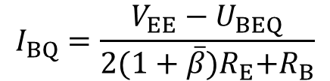

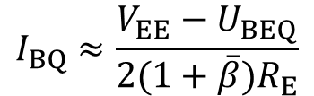
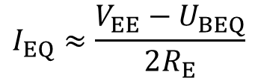
V_{EE}= 2I_{EQ}R_{E}+U_{BEQ}+I_{BQ}R_{B}
+V_{CC}
I_{CQ2}
I_{CQ1}
R_{C}
R_{C}
c
c
b
U_{CEQ1}
U_{CEQ2}
b
R_{B}
e
R_{B}
e
I_{EQ1}
I_{EQ2}
R_{E}
-V_{EE}

Slide 13
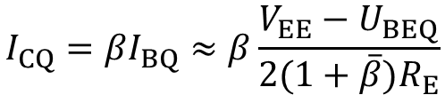
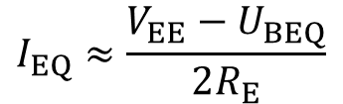
+V_{CC}
V_{CC}+V_{EE} = I_{CQ}R_{C}+U_{CEQ}+2I_{EQ}R_{E}
I_{CQ2}
I_{CQ1}
R_{C}
R_{C}
c
c
b
U_{CEQ1}
U_{CEQ2}
b
R_{B}
e
R_{B}
e
I_{EQ1}
I_{EQ2}
R_{E}
→ U_{CEQ}
-V_{EE}

Slide 14














Dynamic analysis 动态分析
+V_{CC}
R_{C}
R_{C}
R_{C}
R_{C}
R_{L}
R_{L}
R_{B}
R_{B}
R_{B}
R_{B}
+
-
-
+
u_{Od}
+
+
+
+
u_{I1d}
u_{I2d}
-
i_{E1}
i_{E2}
-
-
-
R_{E}
R_{E}
-V_{EE}
R_{C}
R_{C}
R_{L}
+
-
+
R_{B}
R_{B}
-
-
+
R_{E}

Slide 15





















R_{C}
R_{C}
R_{C}
R_{C}
R_{L}
R_{L}
+
-
R_{B}
+
-
R_{B}
+
R_{B}
R_{B}
-
-
+
+
-
+
-
+
-
+
-
R_{L}/2
R_{L}/2
R_{L}
R_{B}
R_{B}
R_{B}
R_{C}
R_{C}
R_{C}
+
-
+
-
+
-
+
-

Slide 16


















1
R_{L}/2
R_{L}/2
+
-
R_{L}/2
R_{L}/2
R_{B}
+
-
+
-
R_{C}
-
-
2
+
+
R_{L}/2
R_{L}/2
+
-
+
-

Slide 17














+
-
1
+
-
R_{L}/2
R_{L}/2
R_{L}/2
R_{L}/2
R_{C}
R_{B}
R_{C}
R_{B}
+
-
+
-
+
-
+
-

Slide 18











+
R_{L}/2
R_{L}/2
-
2
R_{C}
R_{C}
R_{L}/2
R_{L}/2
+
-
+
-
R_{B}
R_{B}
+
-

Slide 19









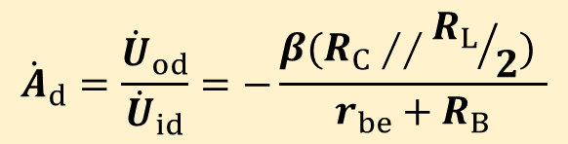


R_{L}/2
R_{L}/2
-
The input voltage
+
R_{C}
R_{C}
The output voltage
The voltage gain
R_{B}
R_{B}
+
-
The voltage gain is the same with the common-e amplifier
Input resistance
Sacrifice one transistor to achieve better stability

Slide 20










+
-
R_{C}
R_{C}
Output resistance
R_{B}
R_{B}

Slide 21
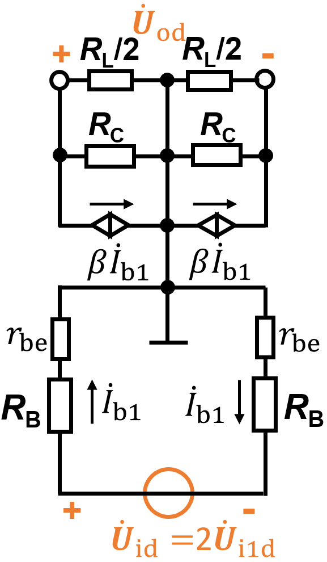
+V_{CC}
R_{C}
R_{C}
R_{L}
R_{B}
R_{B}
-
+
u_{Od}
+
-
u_{I1d}
u_{I1d}
-
i_{E1}
i_{E2}
+
R_{E}
-V_{EE}

Slide 22
+V_{CC}
+V_{CC}
R_{C}
R_{C}
R_{C}
R_{C}
R_{L}
R_{L}
R_{B}
R_{B}
R_{B}
R_{B}
-
-
u_{Od}
+
u_{Od}
+
+
-
u_{I1d}
u_{I1d}
-
i_{E2}
+
i_{E1}
i_{E2}
i_{E1}
R_{E}
+
u_{Id}
R_{E}
-
-V_{EE}
-V_{EE}
u_{Id} = 2u_{I1d}

Slide 23
2）Differential-mode signal 差模信号
Dual-ended input, Single-ended output
双端输入,单端输出
+V_{CC}
R_{C}
R_{C}
+
R_{B}
R_{B}
R_{L}
u_{Od}
-
+
i_{E1}
i_{E2}
u_{Id}
R_{E}
-
-V_{EE}

Slide 24
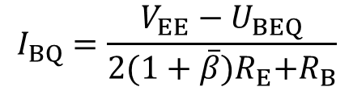

+V_{CC}
DC circuit
R_{C}
R_{C}
+V_{CC}
R_{L}
R_{C}
R_{C}
+
R_{B}
R_{B}
R_{L}
u_{Od}
c
I_{CQ1}
I_{CQ2}
c
-
R_{B}
b
b
+
i_{E1}
i_{E2}
R_{B}
u_{Id}
R_{E}
e
e
-
-V_{EE}
I_{EQ1}
I_{EQ2}
R_{E}
-V_{EE}
The input circuit

Slide 25



DC circuit
+V_{CC}
The output circuit is asymmetric
R_{L}
R_{C}
R_{C}
I_{L}
c
I_{CQ1}
I_{CQ2}
c
R_{B}
b
b
R_{B}
e
e
I_{EQ1}
I_{EQ2}
R_{E}
-V_{EE}
The negative feedback of R_{E} can reduce the zero-drift error. The zero-drift error is larger than the dual-ended output model

Slide 26












+V_{CC}
R_{C}
R_{C}
R_{C}
R_{C}
Dynamic analysis
+
+
R_{B}
R_{B}
R_{B}
R_{B}
R_{L}
u_{Od}
R_{L}
-
-
+
i_{E1}
i_{E2}
+
u_{Id}
R_{E}
R_{E}
-
-
-V_{EE}
+
-
+
-
R_{L}
R_{L}
R_{B}
R_{C}
R_{B}
R_{C}
R_{B}
R_{C}
R_{B}
R_{C}
+
+
-
-

Slide 27














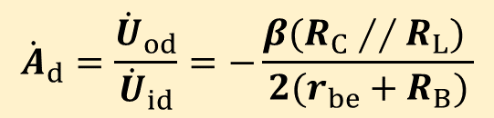
+
-
+
-
R_{L}
R_{L}
R_{C}
R_{C}
R_{B}
R_{C}
R_{B}
R_{C}
+
-
R_{B}
R_{B}
The input voltage
+
-
The output voltage
The voltage gain

Slide 28


















+
-
+
-
R_{L}
R_{C}
R_{C}
R_{C}
R_{C}
R_{B}
R_{B}
R_{B}
R_{B}
+
-
Output resistance
Input resistance

Slide 29


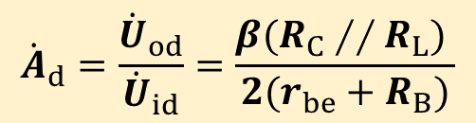

+V_{CC}
-
+
R_{C}
R_{C}
R_{L}
Dynamic analysis
+
R_{C}
R_{C}
R_{B}
R_{B}
u_{Od}
R_{L}
-
+
i_{E1}
i_{E2}
u_{Id}
R_{E}
-
-V_{EE}
R_{B}
R_{B}
+
-
The input voltage
The voltage gain
The output voltage

Slide 30
3）Common-mode signal 共模信号
u_{I1c}=u_{I2c}
The input signal: u_{Ic}=u_{I1c}=u_{I2c}
Dual-ended input/output 双端输入/输出
+V_{CC}
i_{C2}
i_{C1}
R_{C}
R_{C}
R_{L}
R_{B}
R_{B}
+
u_{Oc}
-
+
+
u_{I1c}
u_{I2c}
-
i_{E1}
i_{E2}
-
R_{E}
-V_{EE}

Slide 31

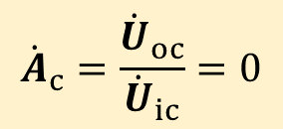
+V_{CC}
i_{C}
i_{C}
R_{C}
R_{C}
R_{L}
R_{B}
R_{B}
+
u_{Oc}
-
+
+
u_{Ic}
u_{Ic}
-
i_{E}
i_{E}
-
R_{E}
-V_{EE}
The output voltage
The voltage gain

Slide 32
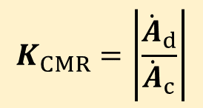

Common-mode rejection ratio 共模抑制比
For ideal differential amplifier, in dual-ended output mode
Larger K_{CMR}, better performance

Slide 33
4）Common-mode signal 共模信号
The input signal: u_{Ic}=u_{I1c}=u_{I2c}
Single-ended output 单端输出
+V_{CC}
R_{C}
R_{C}
+
R_{B}
R_{B}
R_{L}
u_{Oc}
-
+
i_{E1}
i_{E2}
+
u_{Ic}
u_{Ic}
R_{E}
-
-
-V_{EE}

Slide 34

















+V_{CC}
R_{C}
R_{C}
R_{C}
R_{C}
Dynamic analysis
+
+
R_{B}
R_{B}
R_{L}
u_{Oc}
R_{L}
-
R_{B}
-
R_{B}
+
i_{E1}
i_{E2}
+
+
+
u_{Ic}
u_{Ic}
R_{E}
R_{E}
-
-
-
-
-V_{EE}
+
-
+
-
R_{L}
R_{L}
R_{C}
R_{C}
R_{C}
R_{C}
R_{B}
R_{B}
R_{B}
R_{B}
+
+
+
+
R_{E}
R_{E}
-
-
-
-

Slide 35












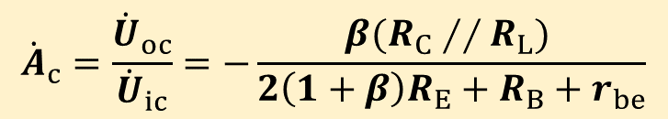
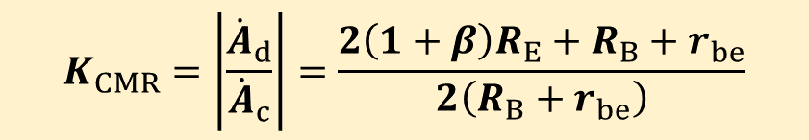
+
-
The input voltage
R_{L}
R_{C}
R_{C}
The output voltage
+
R_{B}
R_{B}
+
The voltage gain
-
R_{E}
-
Common-mode rejection ratio 共模抑制比

Slide 36











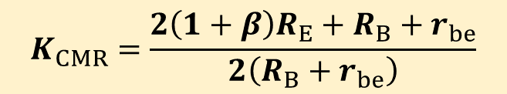
+
-
The voltage gain
R_{L}
R_{C}
R_{C}
Common-mode rejection ratio
+
R_{B}
R_{B}
+
-
R_{E}
-
Larger R_{E}, larger K_{CMR}, better performance!

Slide 37





















+
-
+
-
R_{L}
R_{C}
R_{C}
R_{C}
R_{C}
+
R_{B}
R_{B}
+
R_{B}
R_{B}
R_{E}
R_{E}
-
-
The input resistance
The output resistance

Slide 38
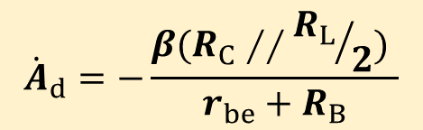


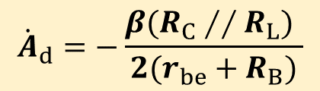


Summary
Differential-mode signal 差模信号
Dual-ended input & output
Input resistance
Output resistance
Dual-ended input & single-ended output
Input resistance
Output resistance

Slide 39



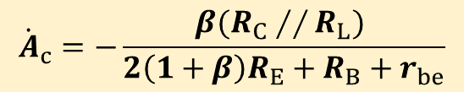


Common-mode signal 共模信号
Dual-ended input & output
Input resistance
Output resistance
Dual-ended input & single-ended output
Input resistance
Output resistance

Slide 40
5）General case: u_{I1} and u_{I2} are arbitrary
+V_{CC}
1
R_{C}
R_{C}
Differential amplifier
R_{B}
+
R_{B}
-
+
u_{O}
u_{I1}
_
+
2
+
+
u_{I2}
u_{I1}
u_{I2}
-
i_{E1}
i_{E2}
-
_
R_{E}
-V_{EE}

Slide 41



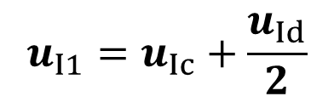
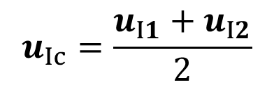
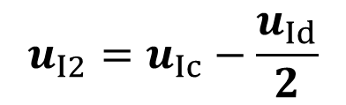
1
1
Differential amplifier
+
Differential amplifier
+
u_{Ic}
u_{I1}
_
+
_
+
2
+
u_{Ic}
2
u_{I2}
_
_
_
_
+
Any signal can be treated as a superposition of differential-mode and common-mode signals

Slide 42

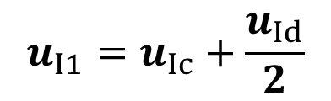
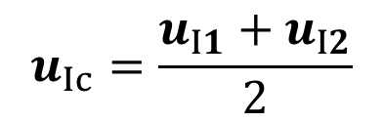
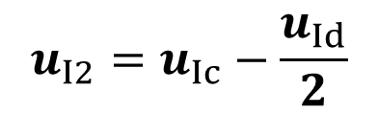

1
1
Differential amplifier
+
Differential amplifier
+
u_{Ic}
u_{I1}
_
+
_
+
2
+
u_{Ic}
2
u_{I2}
_
_
_
_
+
The output voltage

Slide 43



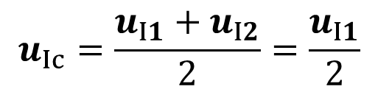


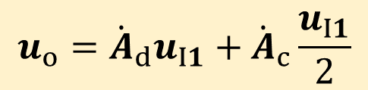

Single-ended input:
+V_{CC}
1
R_{C}
R_{C}
Differential amplifier
+
u_{I1}
R_{B}
R_{B}
_
2
-
+
u_{O}
+
u_{I1}
-
i_{E1}
i_{E2}
R_{E}
-V_{EE}
1
+
Differential amplifier
_
+
+
2
_
_
_
+

Slide 44
4.2.2 Improved differential amplifier: with constant-current source
改进型：带恒流源的差分放大电路
+V_{CC}
i_{C2}
i_{C1}
R_{C}
R_{C}
u_{C1}
+
-
u_{C2}
u_{O}
R_{B}
u_{O1}
R_{B}
T1
-
T2
+
+
u_{I1}
u_{I2}
-
i_{E1}
i_{E2}
-
R_{E}
-V_{EE}
Larger R_{E}, larger K_{CMR}, better performance!
However, when R_{E} is too large, V_{EE} is also very large
E.g. R_{E}=100 kΩ, I_{EE}=0.5 mA, V_{EE}=100.7 V

Slide 45
Use constant current source to replace R_{E}
+V_{CC}
i_{C1}
R_{C}
i_{C2}
R_{C}
u_{C1}
+
-
u_{C2}
u_{O}
R_{B}
u_{O1}
R_{B}
T1
-
T2
+
+
u_{I1}
u_{I2}
-
i_{E1}
i_{E2}
-
I
-V_{EE}
The property of constant current source:
1) Very high AC resistance
High K_{CMR}
2) Low DC resistance
Low V_{EE}

Slide 46


Constant current source made from transistor
Output curve of transistor
I_{C}
i_{C}
I_{BQ}
+
Q
c
i_{B}
b
u_{CE}
+
e
u_{BE}
i_{E}
-
-
0
U_{CE}
DC resistance: R_{CE}
AC resistance: r_{ce}

Slide 47
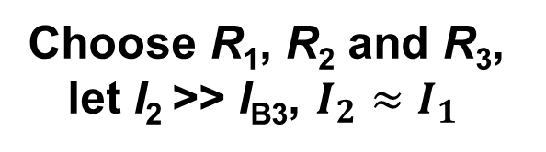
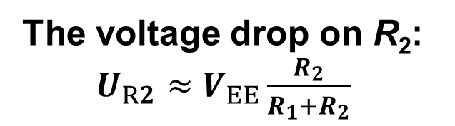
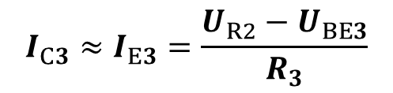
Use constant current source to replace R_{E}
+V_{CC}
i_{C1}
R_{C}
i_{C2}
R_{C}
u_{C1}
+
-
u_{C2}
u_{O}
R_{B}
u_{O1}
R_{B}
T1
-
T2
+
+
u_{I1}
u_{I2}
-
i_{E1}
i_{E2}
-
I_{C3}
I₁
I_{B3}
T3
R₁
I₂
R₂
R₃
I_{E3}
-V_{EE}

Slide 48
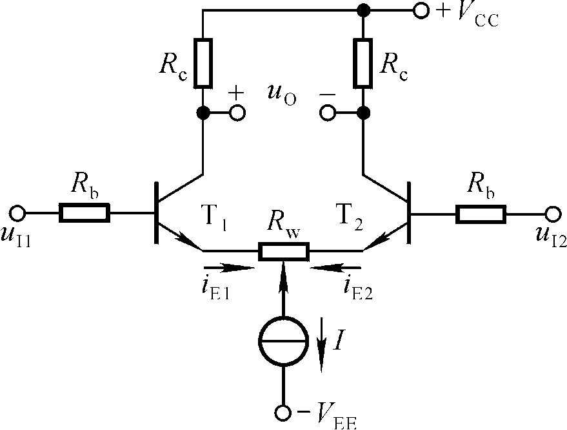
For piratical applications, it is hard to achieve the absolute symmetric circuit. Use a small value resistor R_{W} to adjust the circuit

Slide 49
[Example] As shown in right figure, T₁ and T₂ are identical，b =50，U_{BE}=0.7V，u_{Id} =50mV，u_{Ic}=1V，ask：
(+12V)
+
-
c₁
c₂
U_{C}
I_{C}
+
-
-
+
+
+
-
-
（a）Quiescent working point: I_{C}, U_{C}；
(-12V)
（b）Δu_{O} and K_{CMR}；
（c）If R_{L} is connected between C₁ and ground，ask: U_{C}, Δu_{O} and K_{CMR}。
（d）R_{id}, R_{ic} and R_{o}。

Slide 50
(+12V)
Answer:
For better performance, the sliding side of R_{w} is in the middle。
+
-
c₁
c₂
U_{C}
I_{C}
+
-
-
+
+
+
-
-
(a)
(-12V)

Slide 51
(+12V)
DC circuit
+
-
c₁
c₂
U_{C}
I_{C}
(+12V)
+
-
-
+
+
+
-
-
I_{C}
c₂
U_{C}
c₁
I_{B}
(-12V)
I_{B}
I_{E}
(-12V)

Slide 52

DC circuit
Input circuit:
(+12V)
I_{C}
c₂
U_{C}
c₁
I_{B}
I_{E}
(-12V)

Slide 53
(+12V)
I_{C}
c₂
U_{C}
c₁
I_{B}
I_{E}
(-12V)

Slide 54
(+12V)
（b）
+
-
c₁
c₂
U_{C}
I_{C}
+
-
-
+
+
+
-
-
(-12V)

Slide 55
(+12V)
+
-
c₁
c₂
U_{C}
I_{C}
+
-
-
+
+
+
-
-
(-12V)

Slide 56
(+12V)
(c)
I_{RL}
I_{C}
c₂
U_{C}
c₁
I_{B}
I_{E}
(-12V)

Slide 57
(+12V)
c₁
c₂
+
-
-
+
-
+
+
+
-
-
(-12V)

Slide 58
(+12V)
c₁
c₂
+
-
-
+
-
+
+
+
-
-
(-12V)

Slide 59
(+12V)
(d)Differential mode
+
-
c₁
c₂
U_{C}
I_{C}
+
-
-
+
+
+
Common mode
-
-
(-12V)

Slide 60
(+12V)
+
-
c₁
c₂
Single output terminal:
U_{C}
I_{C}
+
-
-
+
+
+
-
-
(-12V)
Dual output terminal:

Slide 61
4.3 Complementary output stage 互补输出极
The structure of the integrated operational circuit (IOC)
Intermediate stage
Input stage
Output stage
Biasing circuit
偏置电路

Slide 62
4.3 Complementary output stage 互补输出极
Requirement of the output stage:
1) Low output resistance 输出电阻低：负载能力强
2) Low DC power consumption 直流功耗小
3) No DC power consumption on load resistor 负载上无直流功耗：输入为零时输出为零
4) High dynamic range 动态范围尽量大：使最大不失真电压尽可能大

Slide 63
Compare of common -e, -c and -b amplifier
 | Common-e | Common-c | Common-b
 | High | <1 | High
 | Medium | High | Low
 | High | Low | High
andwidth | Narrow | Medium | Wide
No load resistor

Slide 64
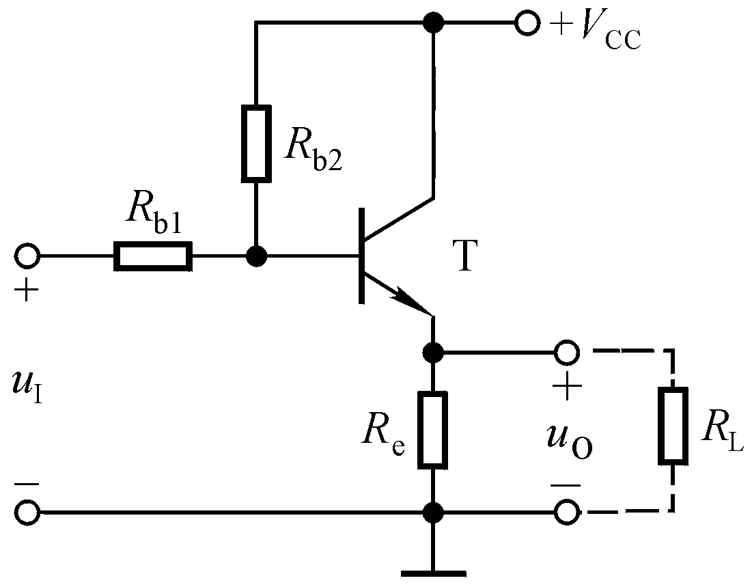
Common-collector amplifier has low output resistance
However,
1) When u_{I}=0, there is DC current on load resistor R_{L}
2) When R_{L} changes, the static working point Q changes
3) When there is R_{L}, the dynamic range decreases

Slide 65
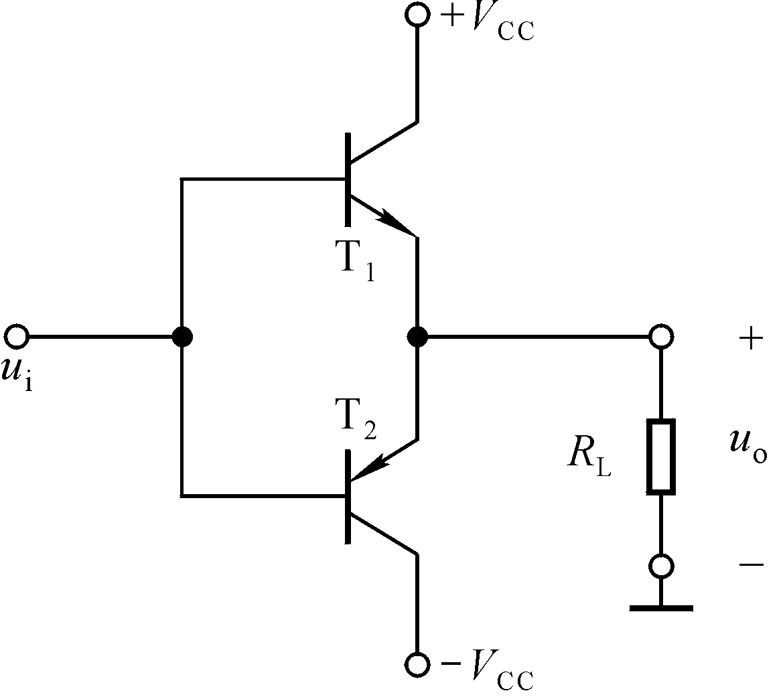
The basic structure of complementary output stage
DC circuit
NPN
NPN
U_{O} = 0
PNP
PNP
No DC current flow through R_{L}

Slide 66
1) Ideal case
i_{B}
NPN
c
NPN
PNP
b
e
Ideal case
e
b
PNP
c
0
u_{BE}
u_{i}
u_{i}>0
T1 √ T2 ⅹ
t
u_{i}<0
T1 ⅹ T2 √
u_{o}
t

Slide 67
2) Real case：Crossover distortion
i_{B}
NPN
Ideal case
Real case
PNP
u_{BE}
U_{on}
u_{i}
U_{on}
u_{i}>U_{on}
T1 √ T2 ⅹ
t
-U_{on}
u_{i}<U_{on}
T1 ⅹ T2 √
u_{o}
t
交越失真
Crossover distortion

Slide 68
How to reduce crossover distortion
i_{B}
b1
NPN
Real case
b2
PNP
U_{on}
u_{BE}
Static voltages at b1 and b2:
U_{b1}= U_{b1} =0
Make static U_{b1} slightly larger than U_{on}, and U_{b2} slightly smaller than –U_{on}!

Slide 69
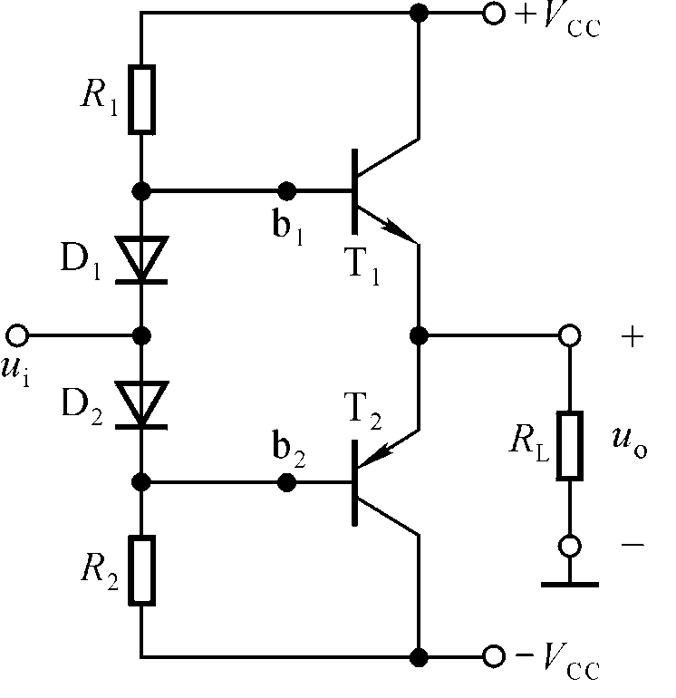



4.3.1 Eliminate crossover distortion
1) Use diodes
i_{B}
U_{on}
u_{BE}
Use the same material for transistors and diodes
Adjust R₁ and R₂ to make U_{D1} slightly larger than U_{on}

Slide 70
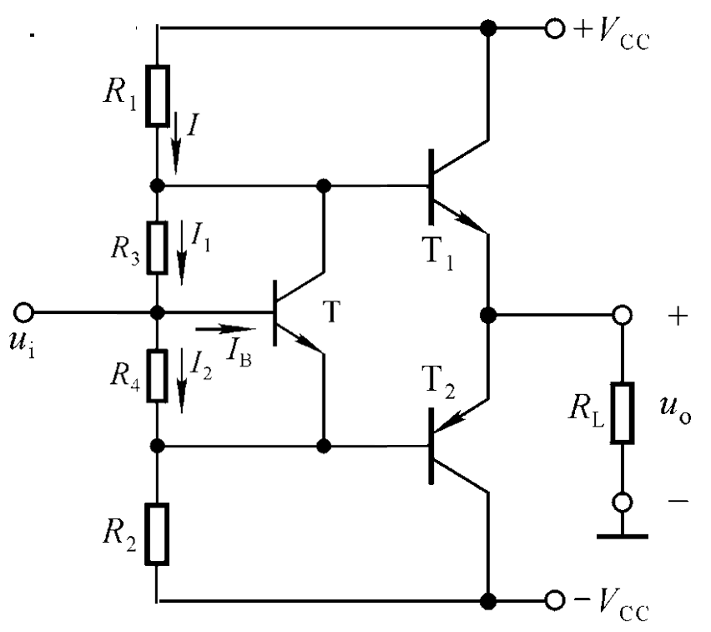
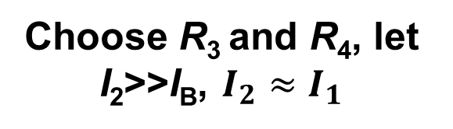

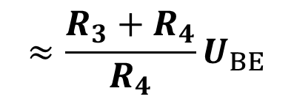
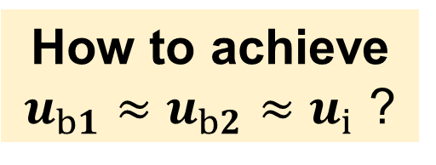
2) U_{BE} multiplying circuit U_{BE} 倍增电路
b1
c
b
e
b2

Slide 71

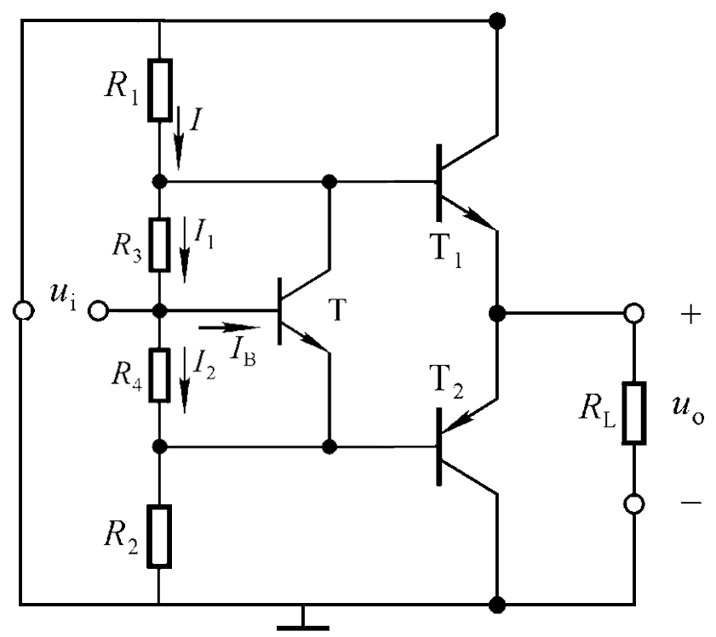
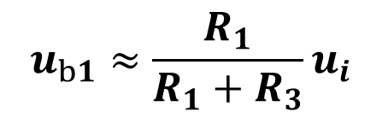
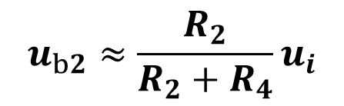


b1
b1
c
b
e
b2
b2

Slide 72
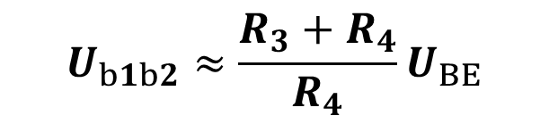
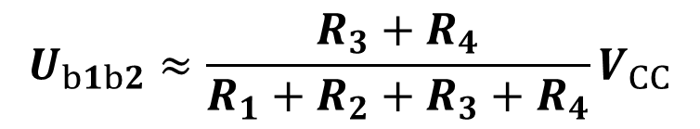
Why use T?
b1
b1
c
c
b
b
e
e
b2
b2

Slide 73
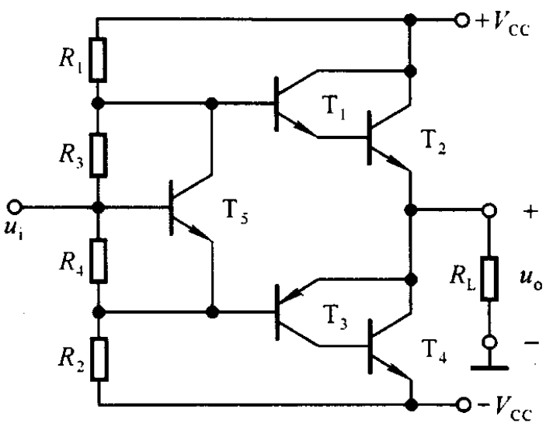
Use composite transistor

Slide 74
Homework 3-3：3.6，3.8 （提交）
总结差分放大电路的4种接法，并分析静态和动态参数

